Slide 1

FinTech Startup Funding: Trends, Insights, and Recommendations
This presentation examines key trends and insights into FinTech startup funding, providing strategic recommendations for both startups and investors. We will explore how funding patterns have evolved, identify key market segments, and highlight geographical variations in investment activity. Join us as we navigate the complex world of startup finance and uncover the crucial elements for success.
CAPSTONE PROJECT SCALAR

Slide 2
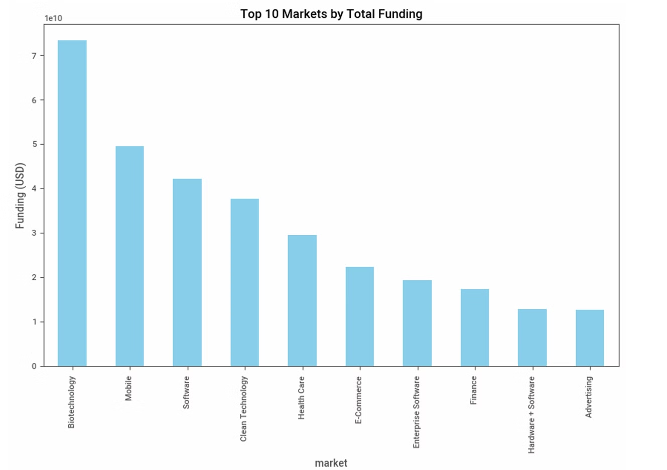
Funding Trends and Distribution
Yearly Funding Trends
Top Markets and Categories
Funding levels fluctuate significantly year-over-year. High-growth years tend to coincide with economic booms, while downturns often lead to decreased investment. However, FinTech remains a resilient sector, attracting significant capital even during challenging market conditions.
Technology and Healthcare consistently dominate FinTech funding. This reflects the significant potential for innovation in these sectors, driving investment towards companies developing groundbreaking solutions. Emerging markets like ClimateTech are experiencing rapid YoY growth, attracting attention for their positive impact and potential for disruptive solutions.

Slide 3
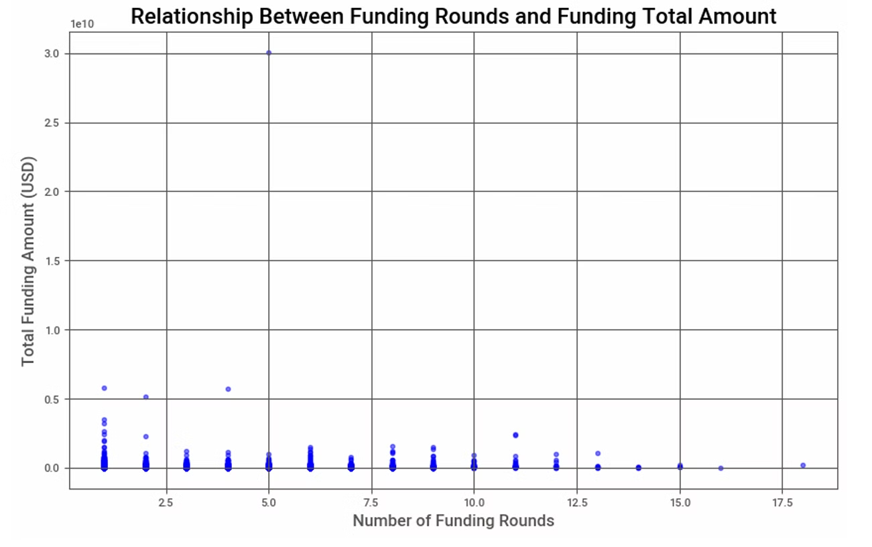
Funding Rounds and Success
1
Seed Funding Prevalence
2
Series B and Beyond
3
Regional Influence on Funding
Seed funding remains a common initial stage of investment for startups. However, it's essential to recognize that seed funding is often significantly lower than later rounds. This underscores the challenge startups face in securing the capital needed to scale and achieve sustainable growth.
The transition from early-stage funding to later rounds, such as Series B and beyond, can be challenging for many startups. A limited number of companies successfully progress to these stages, highlighting the importance of building a strong foundation and demonstrating significant traction before seeking further investments.
Startups in developed regions are more likely to secure multiple funding rounds. This is due to factors like access to capital, experienced investors, and a more mature startup ecosystem. However, emerging regions can foster high-growth potential, attracting investment from venture capitalists and other stakeholders seeking early-stage opportunities.

Slide 4
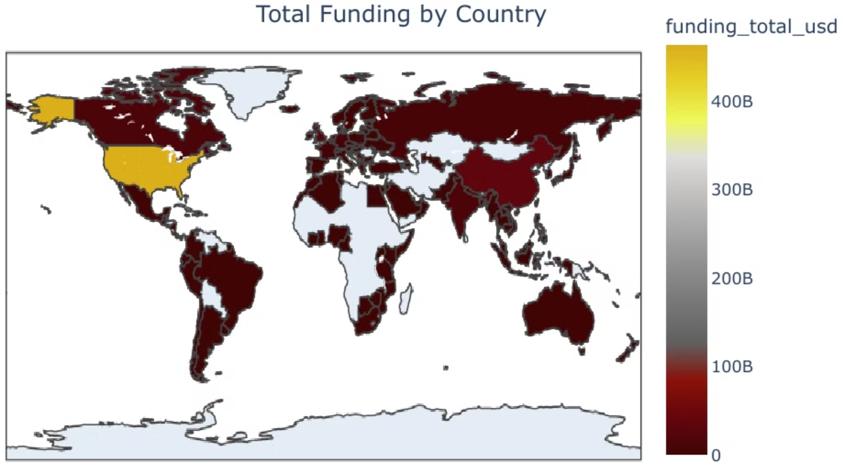
Geographical Trends in FinTech Funding
Regional Insights
City-Level Dominance
North America leads FinTech funding, followed by Europe and Asia. Established financial institutions and technology hubs in these regions explain this. Emerging regions like Africa receive less funding but show significant high-growth potential, especially in mobile payments and financial inclusion.
San Francisco, New York, and London are global startup investment hubs. These areas benefit from concentrated venture capitalists, angel investors, and a skilled workforce in technology and finance.

Slide 5



Market Opportunities
Technology and Healthcare dominate investments, offering robust opportunities for innovation. Emerging sectors like ClimateTech present exciting prospects for ventures focused on sustainable solutions.
1
Regional Considerations
2
Funding is concentrated in North America and Europe, requiring attention towards diversifying investment strategies and exploring opportunities in underfunded regions like Africa.
Funding Round Challenges
3
Many early-stage startups struggle to secure funding beyond the Seed stage. Building strong traction, a compelling business model, and demonstrating a clear path to scalability are critical for securing later-stage investments.
Key Insights for FinTech Startup Funding

Slide 6
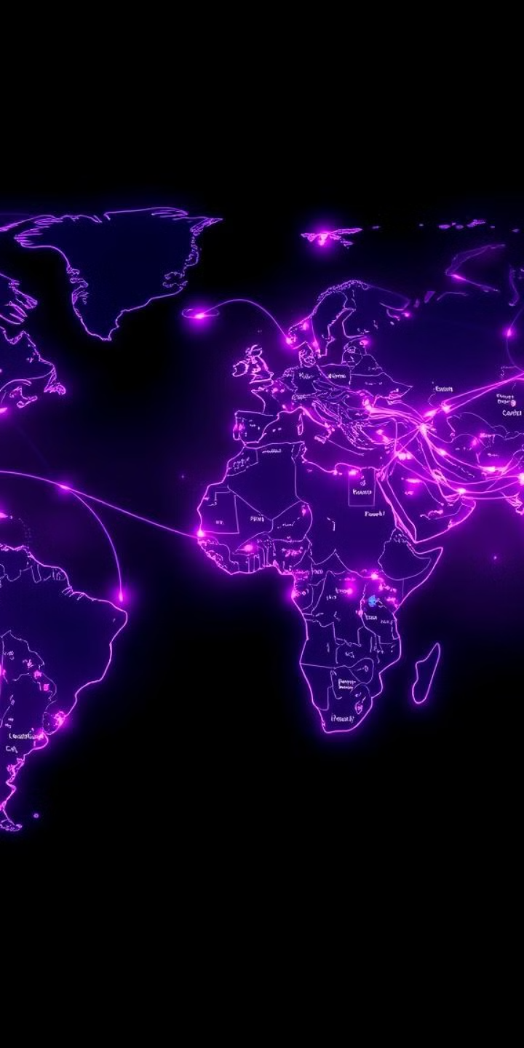


Recommendations for Success in FinTech Funding
Startup Focus
Startups should prioritize high-investment markets like Technology and Healthcare, where innovation is readily rewarded with capital. Building early traction through pilot projects, partnerships, and customer acquisition is crucial for securing later funding rounds.
Investor Diversification
Investors should diversify portfolios to include emerging markets and sectors that offer high growth potential. Targeting sectors like AI, ClimateTech, and EdTech can provide long-term returns and contribute to positive social impact.

Slide 7

Conclusion: Navigating the FinTech Funding Landscape
1
2
3
Market Dynamics
Data-Driven Strategies
Collaboration and Innovation
Funding trends are influenced by a confluence of factors, including market dynamics, regional variations, and prevailing economic conditions. Understanding these factors is essential for navigating the complex world of startup funding.
Data-driven strategies are crucial for both startups and investors. By analyzing market trends, investor preferences, and competition, stakeholders can make informed decisions and optimize their funding strategies.
Collaboration between startups and investors is vital for unlocking growth. Startups benefit from access to capital and expertise, while investors gain exposure to promising ventures and the potential for high returns.

